Slide 1
Lec - 2

Slide 2

RAY DIAGRAM
IMAGE
OBJECT
DISTANCE OF IMAGE FROM THE
OBJECT CAN BE FOUND BY A
METHOD CALLED
RAY DIAGRAM

Slide 3

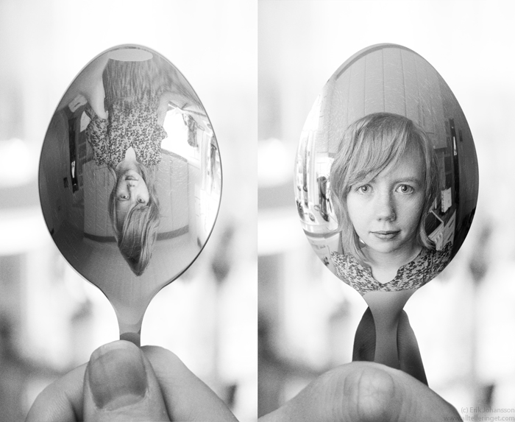
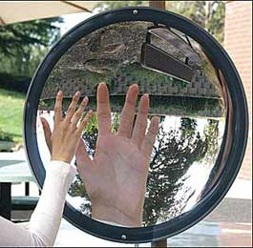
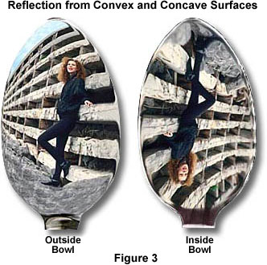
RAY DIAGRAM
It is a method of locating the position, size and nature of the image.
DIMINISHED
IMAGE
ERECT IMAGE
MAGNIFIED IMAGE
INVERTED IMAGE

Slide 4
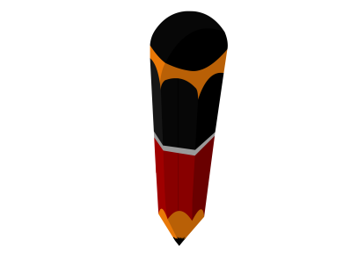
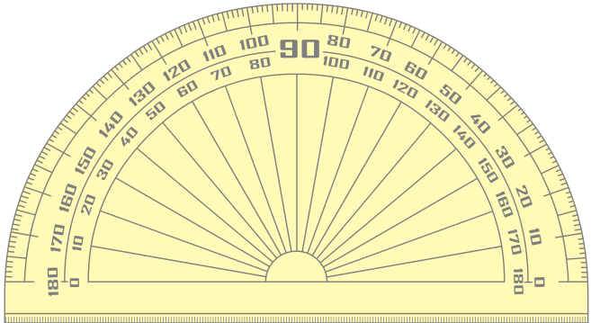
RAY DIAGRAM
BASIC DIAGRAM
Concave mirror
F
2 cm
P
Principal axis
3 cm
C
Focus
Pole
2 cm
0
1
2
3
2
7
8
9
1
4
5
6
9
0
3
7
10
11
12
13
14
15
2
4
5
6
8
10
11
12
13
14
15
0
1
3
4
5
6
7
8
9
10
11
12
13
14
15
Center of curvature

Slide 5
RAY DIAGRAM
RULES FOR MAKING RAY DIAGRAMS
RULE
1
A ray of light which is parallel to the principle axis of a concave mirror, passes through its focus after reflection from the mirror.
A
Incident ray
2 cm
2 cm
3 cm
B
C
F
P
Reflected ray

Slide 6
RAY DIAGRAM
RULES FOR MAKING RAY DIAGRAMS
RULE
2
A ray of light passing through the centre of curvature of a concave mirror, is reflected back along the same path.
A
Incident ray
B
C
F
P
Reflected ray

Slide 7
RAY DIAGRAM
RULES FOR MAKING RAY DIAGRAMS
RULE
3
A ray of light passing through the focus of a concave mirror, becomes parallel to the principal axis after reflection.
A
Incident ray
B
C
F
P
Reflected ray

Slide 8
RAY DIAGRAM
RULES FOR MAKING RAY DIAGRAMS
RULE
4
A ray of light which is incident at the pole of a concave mirror, is reflected back making the same angle with the principal axis.
A
Incident ray
i
B
C
F
r
P
Reflected ray

Slide 9

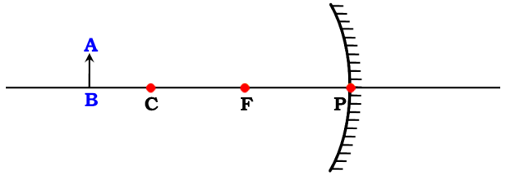
4 RULES FOR MAKING
RAY DIAGRAM
INCIDENT RAY
REFLECTED RAY
INCIDENT RAY
REFLECTED RAY
Parallel to the principal Axis
Passes through focus
Passes through C
Passes through C
INCIDENT RAY
REFLECTED RAY
INCIDENT RAY
REFLECTED RAY
Passes through focus
Parallel to the principal Axis
Strike the pole at an angle
Makes the same angle with principal axis
i
r

Slide 10

OBJECT BEYOND ‘C’
A
B
B
1 cm
2 cm
F
2 cm
P
3 cm
C
A
Position of Image :
Between C and F
Nature of Image :
Real
Inverted
(C) Diminished

Slide 11
OBJECT AT ‘C’
A
B
C
B
F
P
A
Position of Image :
AT C
Nature of Image :
Real
Inverted
(C) Same size

Slide 12
OBJECT BETWEEN ‘F’ AND ‘C’
A
B
C
B
F
P
A
Position of Image :
Beyond C
Nature of Image :
Real
Inverted
(C) Magnified

Slide 13
OBJECT AT ‘F’
A
C
B
F
P
Position of Image :
At infinity
Nature of Image :
Real
Inverted
(C) Highly Magnified

Slide 14
OBJECT BETWEEN ‘P’ AND ‘F’
A
A
C
F
B
P
B
Position of Image :
Behind the mirror
Nature of Image :
Virtual
Erect
(C) Magnified

Slide 15
Thank You

